Slide 1
Setting Up Your Child for School Success
September 18, 2018
Partnership for Extraordinary Minds

Slide 2
Agenda
Getting your files organized
Setting expectations
Setting up systems
What to do when problems arise

Slide 3
Getting Your Files Organized
Getting your files organized is the first and most important step in becoming your child’s advocate
“When you take your organized file to the next school meeting, you will understand the power of getting organized. You will gain a sense of control.”
(Wrightslaw: http://www.wrightslaw.com/info/organize.file.htm)

Slide 4
Approaches to Organization:
Wrightslaw Approach
Create a master binder (or binders depending on number of documents and age of child) of all paperwork and school information
    Make a master provider list: http://www.wrightslaw.com/info/organize.file.htm
    Include reports on any type of testing you have had done
    Include the most recent IEP as well as quarterly progress reports
Least labor intensive approach is to organize chronologically
    Wrightslaw cautions against filing documents by category because trying to determine categories is confusing and time-consuming. “If your system is confusing and difficult, it will fail.”
    Make sure each document is dated; sometimes date of receipt is just as important as date of creation (5-day rule)
    Documents should include logs of conversations or emails that you’ve had with school staff
Maintain a box for collecting all work that comes home from school; you may need to produce work samples if there is a dispute regarding your child’s present levels of performance

Slide 5
Approaches to Organization:
Understood.org Approach
Understood.org suggests organizing your binder by 6 categories:https://www.understood.org/en/school-learning/special-services/ieps/how-to-organize-your-childs-iep-binder
Start with the IEP Binder Checklist
Create 6 tabs
    Communication
      Contact Sheet
      Parent-School Communication Log
    Evaluations
    IEP
    Report Cards/Progress Notes
    Sample Work
    Behavior
      BIP/Behavior Contract
      Disciplinary Notices
Notes:
There are several templates available for download at the link on this slide. xMinds has also created its own templates for a contact sheet, communication log, and behavior log.

Slide 6
Obtain copies of your child’s records
Request a copy of your child's entire cumulative file and confidential file, omitting nothing.
    Expect to pay reasonable photocopying costs
    Volunteer to copy the file yourself
Wrightslaw recommends sending a request letter to school principal and the director of special education.
    Sample letters available in From Emotions to Advocacy

Slide 7
Setting up Expectations: Specifics about your child
What should your child’s teacher(s) expect?
    About Me / Introduction Letter
      https://www.understood.org/en/school-learning/choosing-starting-school/back-to-school/download-back-to-school-introduction-letters
      http://www.chartnc.com/2013/07/free-printable-student-profile-2-in.html
      https://our3lilbirds.blogspot.com/2017/05/how-to-make-one-page-profile-ellie-style.html
Keep subject specialists, specials teachers, and substitutes in the loop
    IEP Snapshot
      http://www.chartnc.com/2013/08/free-back-to-school-printable-iep-at.html
      “Student Snapshot” by Shaina Clay, Asperger Program, Diamond Elementary
Notes:
The About Me Profile or Letter of Introduction is a great project to engage your child in. The process of completing one of these is an excellent opportunity to help you child develop self-awareness and self-advocacy skills. It also allows you to frame your child in positive terms – focusing on strengths and special interests that paint a more rounded picture of your child.

Slide 8
Setting up Expectations: An Opportunity to Educate
Consider providing your child’s teacher with some general information about autism, especially if your child is mainstreamed
    Deciphering Students with Autism, Sarah Wayland, Ph.D.; Susan Keisler; and Monica Adler Werner (https://xminds.org/resources/Documents/ReasonsWhy-Autism.Wayland_Forum2017.pdf)
    Autism and Consequences, Judy Endow (https://ollibean.com/autism-and-consequences/)
    “Understanding the Spectrum,” Theorahh (https://the-art-of-autism.com/understanding-the-spectrum-a-comic-strip-explanation/)

Slide 9
Setting Up Systems: Communication Survey
xMinds conducted a survey regarding the level of satisfaction caregivers had with the communication they received from their child’s educational team
We have some preliminary findings:
    Across all ages and placement types, more caregivers seemed satisfied with the quality rather than the frequency of the communication they received.
    Email is the mostly widely used method of communication.
    Caregivers with students in Elementary Asperger and Behavior Emotional Social Support (BESS) programs expressed a higher level of satisfaction with the communication they received from their child’s team than caregivers of elementary students in other programs or their neighborhood school.
      It is noteworthy that behavior contacts are used in both the Asperger and BESS elementary school programs

Slide 10
Setting UP Systems: Survey Findings Con’t
More preliminary findings include:
    Families with students in their neighborhood elementary schools received markedly less communication from special educators than those families with a student in a special program.
    Caregivers of students in special programs wanted more information about academics being taught in school.
    Caregivers of middle and high school students in their neighborhood school received demonstrably less frequent communication from school and were less satisfied with both the frequency and quality of communication than caregivers of students in special programs.
      All caregivers of students in the Bridge program reported being satisfied or very satisfied with the quality of the communication they received from school.

Slide 11
Setting UP Systems: Survey Recommendations
Once xMinds has finalized its report, we plan to submit the following recommendations to MCPS Special Education:
    Preschool Education Program needs a template that PEP teachers and parent educators can use to report the skills that students are working on and the strategies used in the classroom to foster skills development. The frequency and mechanism of communicating to caregivers should be consistent across all PEP programs district-wide
    Autism Spectrum Disorder Services and BESS should review, compare, and contrast the contracts their programs use and generate a template or model that can used by these programs across the school district.
    Further investigation into whether students in their neighborhood schools are disciplined more frequently for behaviors that would typically be addressed by clinical staff or specialists in special education programs is warranted.
    Caregivers of elementary school students need more frequent communication generally.
      Caregivers of students in special programs need more information about academics being taught and skills being worked on
      Caregivers of students in neighborhood schools need to hear more about progress on IEP goals
Notes:
Talk about discrepancy between how behavioral issues are handled in ES special education programs vs. in ES neighborhood schools

Slide 12
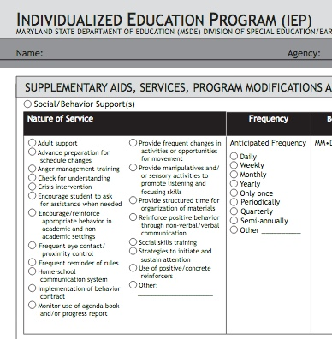
Setting up systems: What You Can Do
Send your child’s teacher an email introducing yourself, your child, and explicitly stating what sorts of information you’re interested in receiving (academics, behavior, self-care skills).
Consider presenting your child’s teacher with a checklist, data sheet, or behavior contract that you’d like completed. This could easily be completed by a paraeducator if the teacher is overworked. Alternatively, your child could be taught to self-monitor and fill out the form on his/her own.
If the teacher resists your overtures, request that “home-school communication system” be included as a supplementary service in the IEP.
Always keep records of phone or personal conversations you have with staff.
Save e-mails and text messages.
Notes:
Make a note that MCPS email servers regularly purge email from teachers accounts every X days. So a parents copy of an email may be the sole existing record.

Slide 13
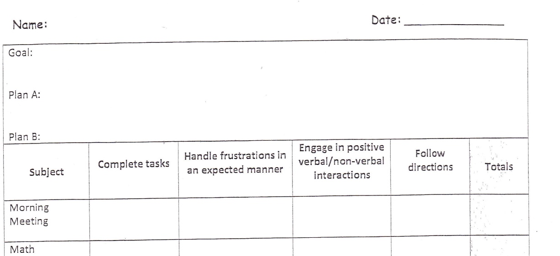
Sample behavior Contracts

Slide 14
Setting Up Systems: Tracking Progress
Understood.org has a free template to help you organize and track your child’s progress on his/her IEP goals: https://www.understood.org/en/school-learning/special-services/ieps/download-iep-goal-tracker
You’ll need your child’s Present Levels of Performance (PLOPs), Goals, and Objectives to complete the template
Collect work samples, progress reports, and note any difficulties your child is having with homework
    Label work samples with the goal number from the IEP, which will help you organize your materials for discussion with the IEP team
Attend the Open House held in October
    This is an opportunity to observe how your child functions in school
Volunteer in your child’s school, if possible, but not necessarily in your child’s classroom.
    You can get a good sense of how peers are performing and the overall climate of the school.
    You will start to know key players in addition to your child’s teacher(s).

Slide 15
When Something Goes Wrong:
Autism Consult
Autism Consult
    MCPS Autism Unit representative observes student in his/her educational setting and writes recommendations for accommodations and/or strategies
    Can be identified as a related service on the IEP
    Parents can ask the IEP Team to request a consult
    Examples of services that can result from the consult:
      Teaching staff specific strategies
      Conducting an Functional Behavior Assessment (FBA)
      Assisting staff in implementing a Behavior Intervention Plan (BIP)
      Attending the student’s IEP meeting

Slide 16
When Something Goes Wrong:
FBA and BIP
Behavior is communication!
A Functional Behavior Assessment (FBA) is an approach to understanding what function a particular interfering behavior is serving for a student (e.g. escaping demands, seeking attention).
FBAs are also sometimes referred to as ABC data:
    Antecedent: what happened just before a behavior occurred
    Behavior: what is the interfering behavior
    Consequences: what happened to the student as a consequence of the behavior
The ABC data is likely to show a pattern of behaviors that explain why the student acts in a certain way.
    The student’s needs aren’t being met, so he/she engages in behavior to get something that he/she needs.
    Once you have this information, you can find an appropriate replacement for the interfering behavior that will meet the student’s need.
The Behavior Intervention Plan (BIP) is generated based on the data in the FBA
    The BIP should target behaviors identified in the FBA.
    A good BIP introduces appropriate replacement behaviors.
Notes:
[FBA] What teachers frequently label “non-compliance” or “opposition” behavior may actually the outward manifestation of a skills deficit. The only way to truly know what motivates a child to act in a certain way is to TAKE DATA!
[BIP] If the BIP merely calls for the elimination of certain behaviors, new undesired behaviors will probably emerge. The underlying need must be met by the replacement behavior.

Slide 17
When Something Goes Wrong:
Taking it up the Chain of Command
When you and the IEP team or you and the principal cannot agree, it’s time to contact the next level on the chain of command
For issues that are purely related to your child’s particular school or problems with the principal, contact the Director of Learning, Achievement, and Administration (DLAA) assigned to your child’s school: https://www.montgomeryschoolsmd.org/uploadedFiles/departments/clusteradmin/OSSI%20Area%20Associate%20Superintendent%20Team%20Assignments%20FY19(1).pdf
For issues related to your child’s special education, contact the Special Education Area Supervisor: https://www.montgomeryschoolsmd.org/departments/special-education/contact-us/clusters.aspx

Slide 18
How Can I Find out Whom to Contact?
Effective July 1, MCPS reorganized central administration in Special Education and the Office of School Support and Improvement (OSSI).
Now there are 3 Special Education Area Supervisors covering the entire school district, whereas there were previously 6. The rationale behind this change that reducing the number of positions at the central level would allow more administrators to be reallocated to the school level.
You can find our full explanation of the reorganization at: https://xminds.org/past-events/

Slide 19
Who is My New Special Education Area Supervisor?
Eric Kuhn oversees
  Clarksburg, Sherwood, Watkins Mill, Quince Orchard, Seneca Valley, Walter Johnson, Gaithersburg, and Northwest Clusters
  Blair G. Ewing Center
  Longview Center
  Regional Institute for Children and Adolescents (RICA)
Claudette Smith oversees
  Kennedy, Magruder, Rockville, Winston Churchill, Einstein, Richard Montgomery, Blake, Paint Branch, and Walt Whitman Clusters
  Carl Sandburg Learning Center
  Rock Terrace
  Stephen Knolls
Melissa Brunson oversees
  Blair, B-CC, Northwood, Wheaton, Wooton, Damascus, Poolesville, and Springbrook Clusters
  Lathrop E. Smith Center
  Thomas Edison

