Slide 1
Sneak Preview of Maryland Online IEP
July 2017

Slide 2
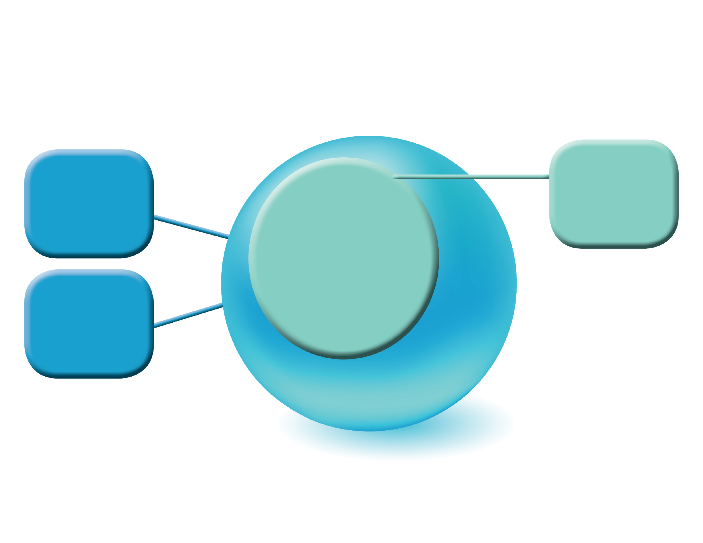
Structure of Maryland Online IEP
Administrative and Case Manager Resources
Developing, Amending an IEP
Auditing an IEP
Closing & Printing an IEP
IEP Module
Analyzing Data in Active IEPs
Student Compass
Notes:
Key Point(s)/Guiding Question(s):
The structure of the MOIEP is divided into two major categories.
Time Suggestion: 2 minutes
Critical Information/Step(s):
The Student Compass component provides supporting information surrounding the IEP.
Available in Student Compass is the ability to analyze data in active and inactive IEPs.
The IEP Module is used for the development of the standards-aligned IEPs.
The IEP Modules users can view, amend, create next and print IEPs.
Engagement:
Presenter: Discussing PowerPoint Slide
Participants: Viewing PowerPoint

Slide 3
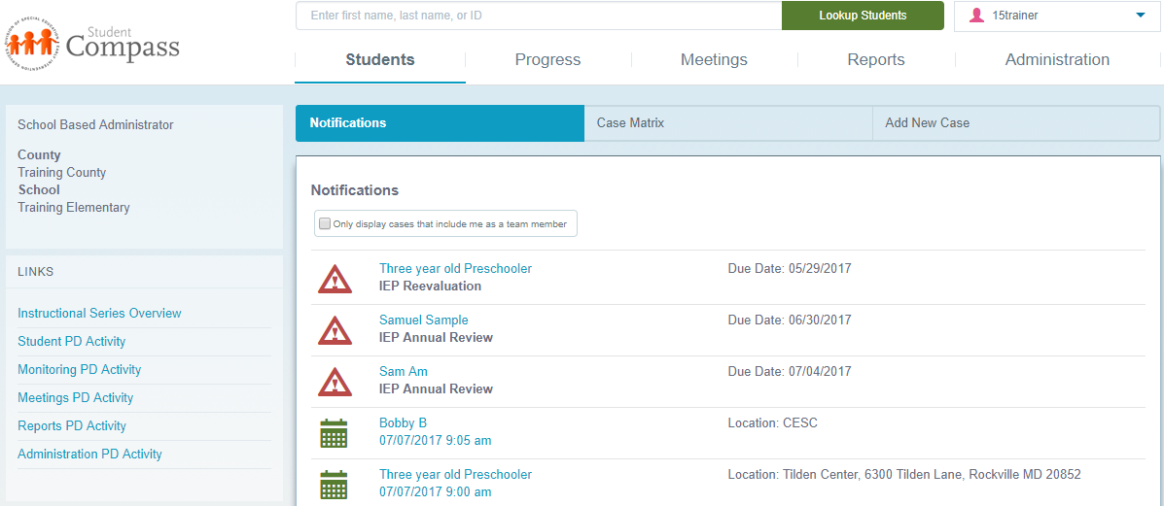
Student Compass
The Student Compass is the module displayed upon logging into the system that has all the supporting information surrounding the IEP.

Slide 4
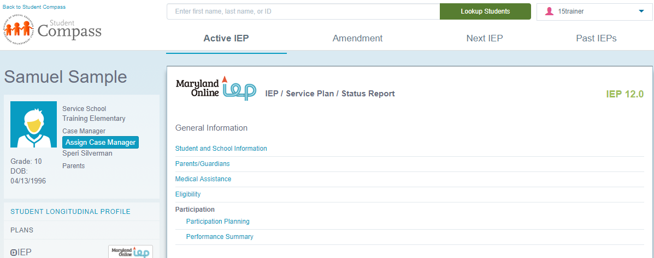
IEP Module
The IEP Module is the module to begin an IEP, to continue to develop, and/or to review a prior IEP associated with the case.

Slide 5
Data Structure Within MOIEP
Information and data available for all students on caseload
Case Matrix to search for a student
Case level progress monitoring and notifications
Caseload Level
Create an IEP, Amendment, Next IEP Service Plan or Eligibility 3, 4, or 6 Status Report
Close & Print IEP
Forms & Logs
Individual Student level data and information
IEP Summary
Student Level
Notes:
Key Point(s)/Guiding Question(s):
The information in MOIEP can be viewed from the Caseload or Student Level.
Time Suggestion: 2 minutes
Critical Information/Step(s):
The Caseload Level provides information on all students on your caseload.
The Student Level provides information about one student.
Engagement:
Presenter: Discussing PowerPoint Slide
Participants: Viewing PowerPoint

Slide 6
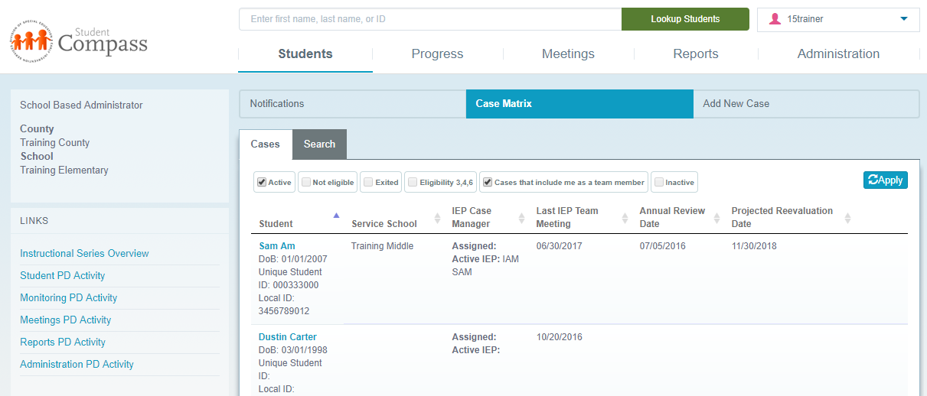
Key Components of Student Compass
Section
Button
Tab
Notes:
Key Point(s)/Guiding Question(s):
The Caseload Level provides information about students on your caseload. Key components of the screen are Sections, Buttons and Tabs.
Time Suggestion: 2 minutes
Critical Information/Step(s):
Section, Buttons and Tabs change depending if you’re at the Caseload or Student Level.
Tabs are based on the buttons you select.
You are at the Caseload Level until you click on a student’s name which will then put you at the Student Level.
Tip: When you are at the Caseload Level, the information in the left panel will have the user’s information and caseload information.
Engagement:
Presenter: Discussing PowerPoint Slide
Participants: Viewing Training site

Slide 7
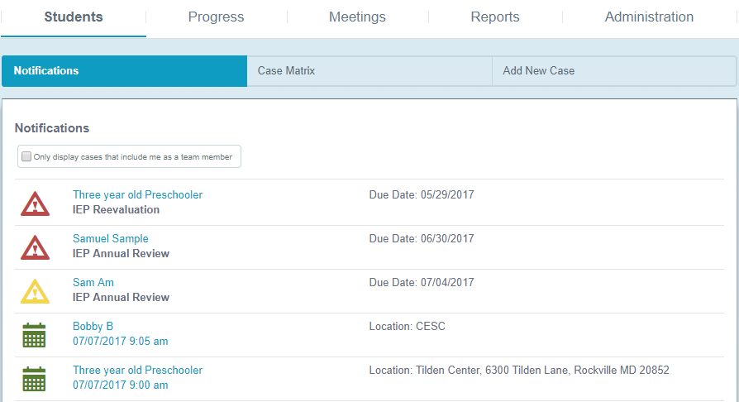
Notification at the Caseload Level
Notification provides reminders of upcoming events.
Notes:
Key Point(s)/Guiding Question(s):
Notifications shows all upcoming events for all students in which the user has access.
Time Suggestion: 2 minutes
Critical Information/Step(s):
Some of the events may be alerts (indicated by the yellow triangle with an exclamation point) for events that are due within the next 90 days.
Or, the events may be scheduled meetings (indicated by a calendar icon). Also indicated on this screen is the location for a scheduled meeting and/or the due date for an IEP Annual Review or Reevaluation.
This list can be quite extensive as it includes all students the user has access to, which in some cases (school based administrator user account), could be an entire school’s special education population. To narrow the list and only see only students on your caseload, select check box for “Only display cases that include me as a team member”.
Engagement:
Presenter: Discuss PowerPoint Slide
Participants: Viewing Training Site

Slide 8
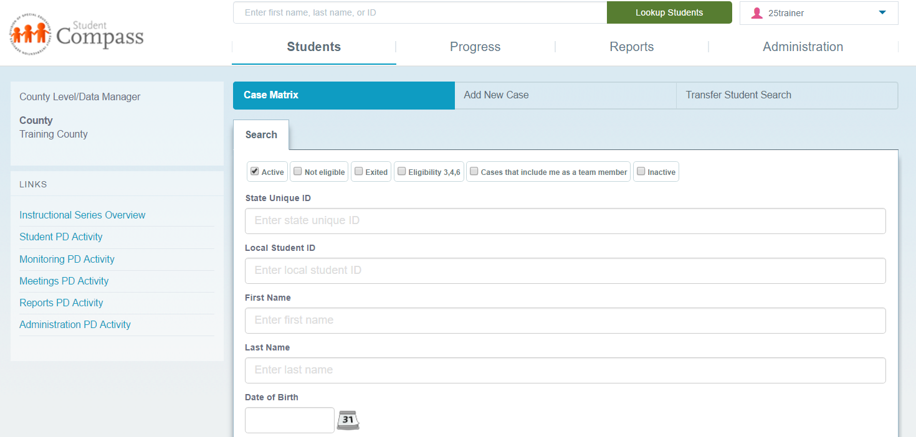
Student Search – Using Case Load Method
Ability to Search by Student ID, Last Name, First Name or Date of Birth
Notes:
Key Point(s)/Guiding Question(s):
Student information can be accessed using the Case Matrix button and the Search Tab.
Time Suggestion: 2 minutes
Critical Information/Step(s):
Choose the Students then click Case Matrix
Determine fields Active, Not Eligible, Exited, Eligibility 3, 4 or 6, Cases that include me as a team member, Inactive
Search by State ID, Local ID, First Name, Last Name or Date of Birth
Engagement:
Presenter: Discussing PowerPoint Slide
Participants: Viewing in Training Site

Slide 9
Student Search – Using Search Bar
Type First Name, Last Name or ID – Click Look-up Student
Notes:
Key Point(s)/Guiding Question(s):
Student information can be accessed using the Search Bar located above Case Matrix, at the very top.
Time Suggestion: 2 minutes
Critical Information/Step(s):
Type in first name, last name or ID.
Click Lookup Student – (Do not press Enter).
Click on student’s name to view record.
Engagement:
Presenter: Discussing PowerPoint Slide
Participants: Using Search Bar to locate Demonstration Student – Make sure all participants have located their Demonstration Student.

Slide 10
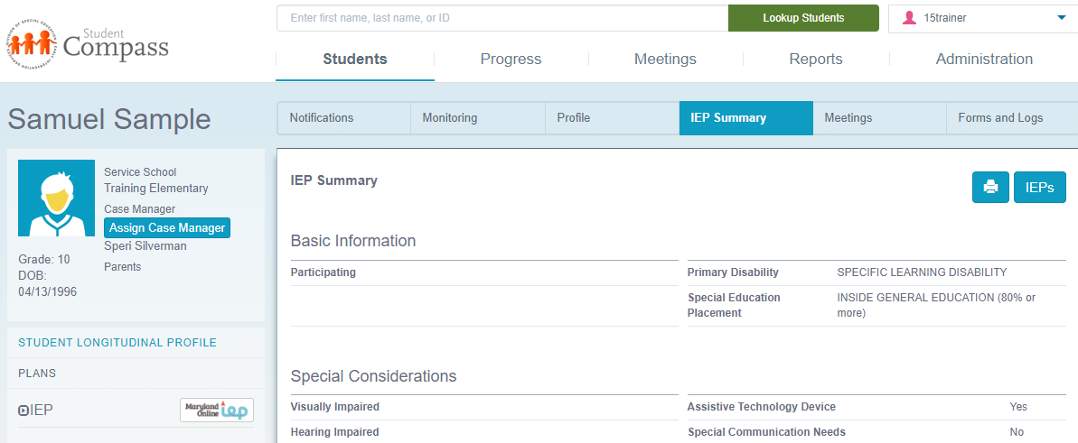
Methods for Accessing the IEP
2
1
Notes:
Key Point(s)/Guiding Question(s):
Introduce three methods for accessing an IEP.
Time Suggestion: 2 minutes
Critical Information/Step(s):
Navigate to IEP by clicking on the IEPs button from the left panel. (1) – Clicking Back to Student Compass will return to Student Compass.
Access the IEP Summary page. (2) The IEP Summary page provides: Basic Information; Special Considerations; Services; Test Scores: PLAAFP; Goals & Goal Progress. This document can be printed to share with educators that work with the student. IEP Summary page summarizes the IEP. However it is not the legal IEP. The IEP can be accessed from the IEP Summary page. (3)
Engagement:
Presenter: Discussing PowerPoint Slide
Participants: Viewing Training Site

Slide 11
IEP Table of Contents
Once the type of IEP is chosen, the Table of Contents will be displayed. From here, the user can select the element of the IEP that needs to be developed or reviewed.
Notes:
Key Point(s)/Guiding Question(s):
Once the type of IEP is chosen, the Table of Contents will be displayed. From here, the user can select the element of the IEP that needs to be developed or reviewed.
Time Suggestion: 2 minutes
Critical Information/Step(s):
The Table of Contents for the IEP appears in a linear list but in fact, any element of the IEP can be chosen in any order as you work through completing the IEP.
This information in this presentation will take a linear approach to review a developed IEP.
Wizards are available in the tool to help and support the development of a standards-aligned IEP.
Engagement:
Presenter: Discussing PowerPoint Slide
Participants: Viewing Training Site

Slide 12
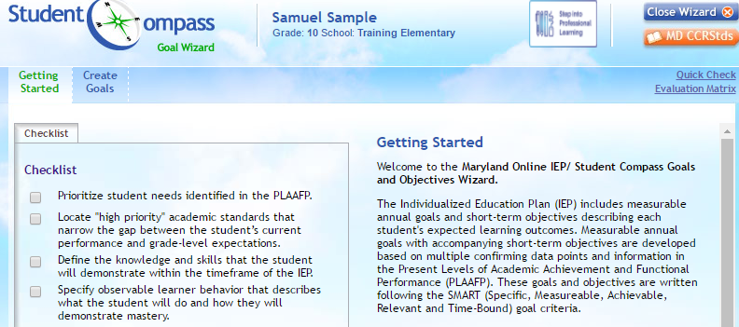
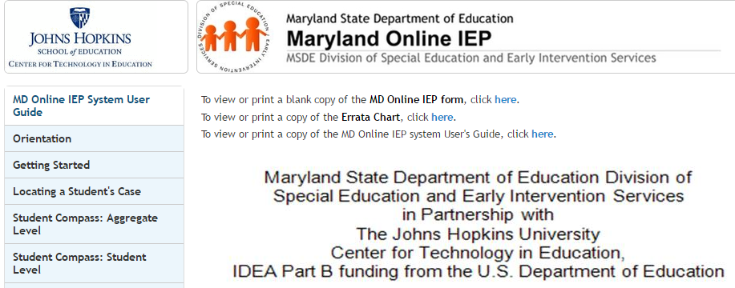
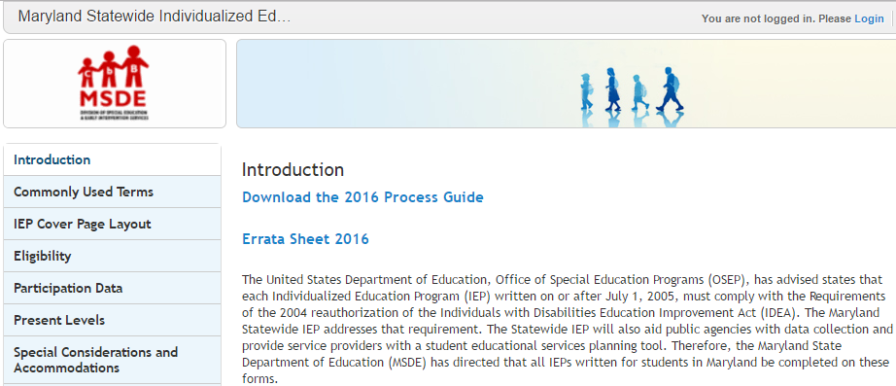
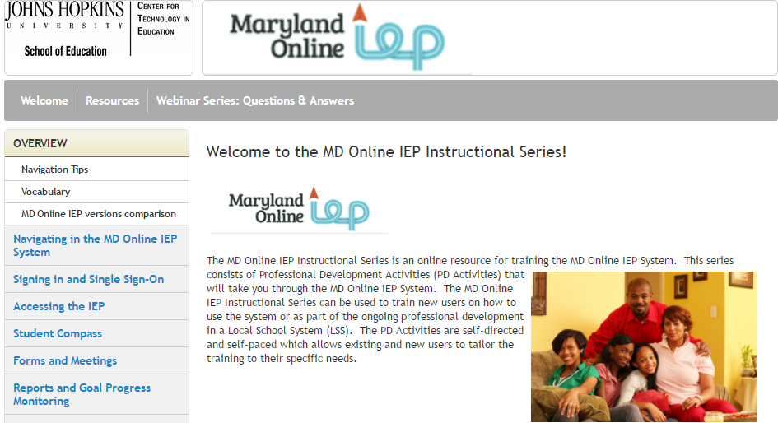
Resources and Supports Available
User Guide
Wizards
Process Guide
Instructional Series

